Slide 1


Exploratory Data Analysis and Visualisation
08
PART II · FROM DATA TO INSIGHT
CHAPTER 8 · WEEK 5
Data Science — From Foundations to Intelligent Systems
LECTURER
Dr. Mustafa Hameed
THE ISLAMIA UNIVERSITY OF BAHAWALPUR
Bahawalpur, Pakistan
Department of Information Technology · BSIT · Fall 2026
Notes:
Chapter 8: Exploratory Data Analysis and Visualisation. Part 2 — From Data to Insight. Week 5: Exploratory analysis. Handout pages 49–54.

Slide 2

Where this chapter sits
THE COURSE
PART I
PART II
PART III
PART IV
PART V
PART VI
1
2
3
4
5
6
7
8
9
10
11
12
13
14
15
16
17
18
19
20
21
22
23
24
25
26
27
28
29
30
31
32
Exploratory Data Analysis and Visualisation
BUILDS ON
USED LATER IN
Ch 5 Describing Data: Centre, Spread and Shape
Ch 10 Relationships and Causality
Ch 7 Acquisition, Wrangling and Cleaning
Ch 12 Supervised Learning I: Regression
Ch 31 Communicating Data Science
Data Science · Chapter 8 · Exploratory Data Analysis and Visualisation
Handout p. 49 2
Notes:
Place the chapter. Before you start: Chapter 5 (centre, spread, shape) and Chapter 7 (you cannot explore data you have not cleaned).

Slide 3

What you will be able to do
LEARNING OUTCOMES
By the end of this chapter you will be able to:
1
Conduct a structured EDA: univariate, then bivariate, then multivariate.
2
Select the correct chart for a given pair of variable types.
3
Read a correlation heatmap and recognise multicollinearity.
4
Identify the common visualisation anti-patterns and explain the distortion each causes.
5
Design a dashboard around the decision it supports rather than the data available.
Data Science · Chapter 8 · Exploratory Data Analysis and Visualisation
Handout p. 49 3
Notes:
Read these out: they are the chapter's contract with the room. Each click adds one.

Slide 4

Vocabulary for this chapter
KEY TERMS
exploratory data analysis
univariate, bivariate, multivariate
histogram
boxplot
scatterplot
correlation matrix
heatmap
small multiples
multicollinearity
Simpson’s paradox
data-ink
dashboard
Each term is defined where it first matters — not here.
Data Science · Chapter 8 · Exploratory Data Analysis and Visualisation
Handout p. 49 4
Notes:
Do not define these now; they arrive one at a time. This slide is for the students' notes. Terms: exploratory data analysis; univariate, bivariate, multivariate; histogram; boxplot; scatterplot; correlation matrix; heatmap; small multiples; multicollinearity; Simpson’s paradox; data-ink; dashboard.

Slide 5

In this chapter
IN THIS CHAPTER
8.1
What EDA Is For
p. 49 ›
8.2
Choosing the Right Chart
p. 49 ›
8.3
Bivariate Exploration
p. 50 ›
8.4
The Third Variable
p. 51 ›
8.5
Visualisation Anti-Patterns
p. 51 ›
Data Science · Chapter 8 · Exploratory Data Analysis and Visualisation
Handout pp. 49–54 5
Notes:
The route through the chapter. Each row is a link: click it to jump to that section in the slide show.

Slide 6
What EDA Is For
SECTION 1 OF 5
8.1
8.1 What EDA Is For
8.2 Choosing the Right Chart
8.3 Bivariate Exploration
8.4 The Third Variable
8.5 Visualisation Anti-Patterns
Data Science · Chapter 8
Handout §8.1 6
Notes:
Pause. Name the question this section answers.

Slide 7

Exploratory Data Analysis
DEFINITION
The systematic use of summaries and graphics to understand a dataset’s structure, find its problems and generate hypotheses — before any model is fitted. Its output is not a chart; it is a list of things you now know and things you now suspect.
Data Science · Chapter 8 · Exploratory Data Analysis and Visualisation
§8.1 · Handout p. 49 7
Notes:
Read the box aloud, then ask for an example from the room before moving on.

Slide 8
What EDA Is For
IN BRIEF
EDA answers four questions, in order:
1. What does each variable look like on its own? (distribution, outliers, missingness)
2. How do pairs of variables relate? (correlation, group differences)
3. Does anything change when a third variable is held constant? (confounding)
4. Is anything here that should not be? (impossible values, leaks, duplicates)
Data Science · Chapter 8 · Exploratory Data Analysis and Visualisation
§8.1 · Handout p. 49 8
Notes:
Read the box aloud, then ask for an example from the room before moving on.

Slide 9
Choosing the Right Chart
SECTION 2 OF 5
8.2
8.1 What EDA Is For
8.2 Choosing the Right Chart
8.3 Bivariate Exploration
8.4 The Third Variable
8.5 Visualisation Anti-Patterns
Data Science · Chapter 8
Handout §8.2 9
Notes:
Pause. Name the question this section answers.

Slide 10
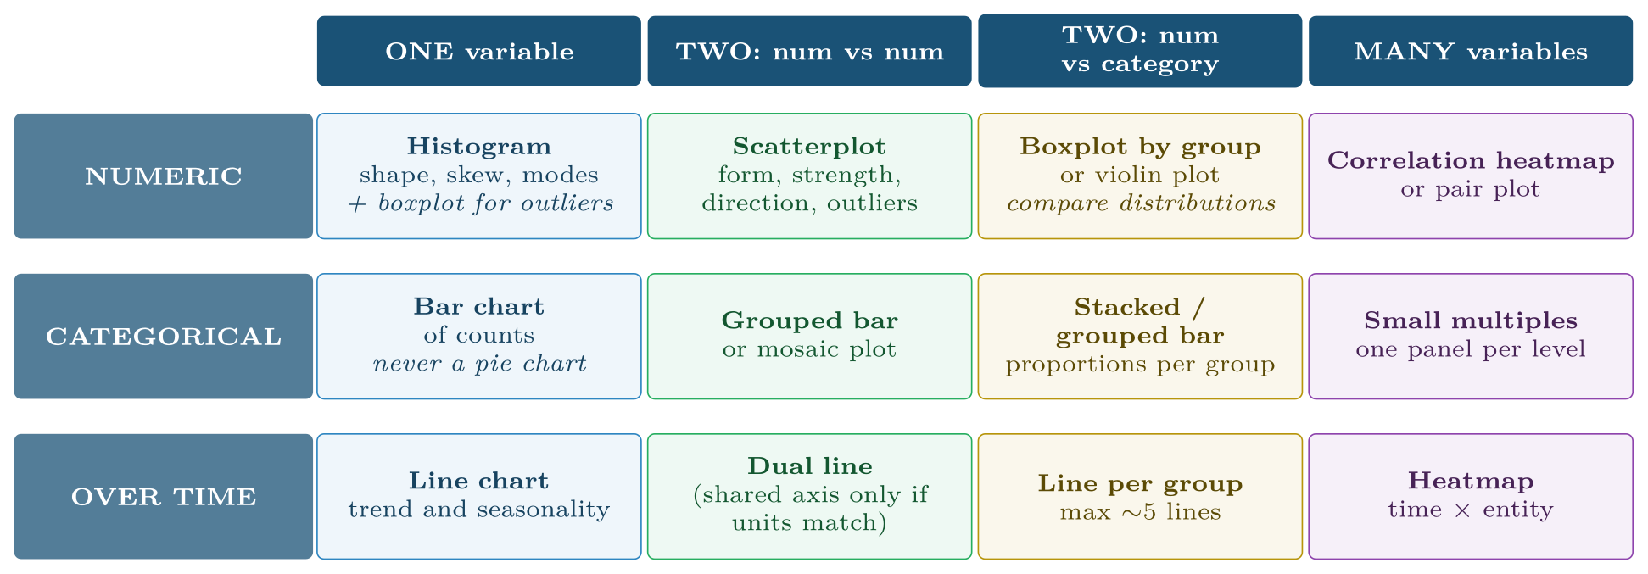
Chart selection by variable type
FIGURE 8.1
Almost every “which chart should I use?” question is answered by identifying the types involved and reading off this grid.
Data Science · Chapter 8 · Exploratory Data Analysis and Visualisation
§8.2 · Handout p. 49 10
Notes:
The choice is almost entirely determined by the types of the variables involved — which is why Chapter 3 came first.
Figure 8.1 (handout p. 50): Chart selection by variable type. Almost every “which chart should I use?” question is answered by identifying the types involved and reading off this grid.

Slide 11

Why Not a Pie Chart
WATCH OUT
Humans compare lengths accurately and angles badly. A bar chart lets a reader rank six categories at a glance; a pie chart of the same data does not. Reserve pies for the one case they handle well: two or three parts of an obvious whole.
Data Science · Chapter 8 · Exploratory Data Analysis and Visualisation
§8.2 · Handout p. 49 11
Notes:
Read the box aloud, then ask for an example from the room before moving on.

Slide 12
Bivariate Exploration
SECTION 3 OF 5
8.3
8.1 What EDA Is For
8.2 Choosing the Right Chart
8.3 Bivariate Exploration
8.4 The Third Variable
8.5 Visualisation Anti-Patterns
Data Science · Chapter 8
Handout §8.3 12
Notes:
Pause. Name the question this section answers.

Slide 13
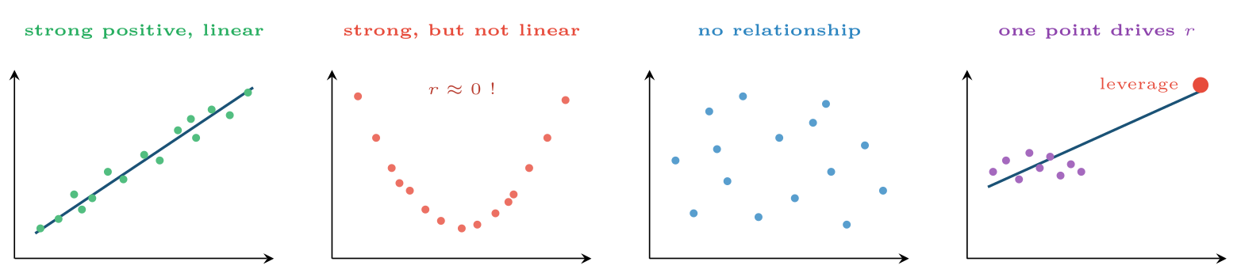
Four scatterplots
FIGURE 8.2
The second has a perfect relationship and a correlation near zero; the fourth has a correlation near 0.9 created entirely by one point. This is why you plot the data before trusting any correlation coefficient.
Data Science · Chapter 8 · Exploratory Data Analysis and Visualisation
§8.3 · Handout p. 50 13
Notes:
Figure 8.2 (handout p. 50): Four scatterplots. The second has a perfect relationship and a correlation near zero; the fourth has a correlation near 0.9 created entirely by one point. This is why you plot the data before trusting any correlation coefficient.

Slide 14
Pearson Correlation
DEFINITION
r measures the strength and direction of a linear relationship, on a scale from −1 to +1. Zero means no linear relationship — it does not mean no relationship, as Figure 8.2 shows.
Data Science · Chapter 8 · Exploratory Data Analysis and Visualisation
§8.3 · Handout p. 50 14
Notes:
Read the box aloud, then ask for an example from the room before moving on.

Slide 15

Reading a Correlation Matrix
WORKED EXAMPLE
An engagement dataset gives these correlations with the target final_mark:
Feature | r with mark | r with attendance
attendance_pct | 0.62 | 1.00
lectures_watched | 0.58 | 0.94
quizzes_done | 0.55 | 0.41
forum_posts | 0.21 | 0.18
days_since_login | −0.49 | −0.73
Reading 1 — predictive strength. Attendance is the strongest single predictor at r = 0.62. Squaring it, r² = 0.38: attendance alone accounts for about 38% of the variation in marks. Useful, but 62% is elsewhere.
Data Science · Chapter 8 · Exploratory Data Analysis and Visualisation
§8.3 · Handout p. 50 15
Notes:
Each click adds one step of the working. Ask for the next number before you reveal it.

Slide 16
Reading a Correlation Matrix (continued)
WORKED EXAMPLE
Reading 2 — multicollinearity. attendance_pct and lectures_watched correlate at 0.94 with each other. They are nearly the same variable measured twice. Including both adds almost no information and makes the coefficients of a linear model unstable and uninterpretable (Chapter 12). Keep one.
Reading 3 — the weak feature. forum_posts at r = 0.21 looks negligible. Do not drop it yet: correlation only sees linear effects, and a feature that is weak alone can be valuable in combination (Chapter 15).
Reading 4 — sign. days_since_login is negative, as it should be. A positive sign here would have signalled a data error worth chasing.
Data Science · Chapter 8 · Exploratory Data Analysis and Visualisation
§8.3 · Handout p. 50 16
Notes:
Each click adds one step of the working. Ask for the next number before you reveal it.

Slide 17
The Third Variable
SECTION 4 OF 5
8.4
8.1 What EDA Is For
8.2 Choosing the Right Chart
8.3 Bivariate Exploration
8.4 The Third Variable
8.5 Visualisation Anti-Patterns
Data Science · Chapter 8
Handout §8.4 17
Notes:
Pause. Name the question this section answers.

Slide 18
Simpson’s Paradox
WATCH OUT
A relationship visible in aggregated data can reverse when the data is split by a third variable. A university may show that students who use the online tutorials score lower overall — while within every individual programme, tutorial users score higher. The aggregate is dominated by the fact that harder programmes both recommend tutorials more and mark more severely.
The practical instruction: whenever you show a relationship, ask what the obvious grouping variable is, and re-plot within groups before you present it. Chapter 10 treats this properly as confounding.
Data Science · Chapter 8 · Exploratory Data Analysis and Visualisation
§8.4 · Handout p. 51 18
Notes:
Read the box aloud, then ask for an example from the room before moving on.

Slide 19
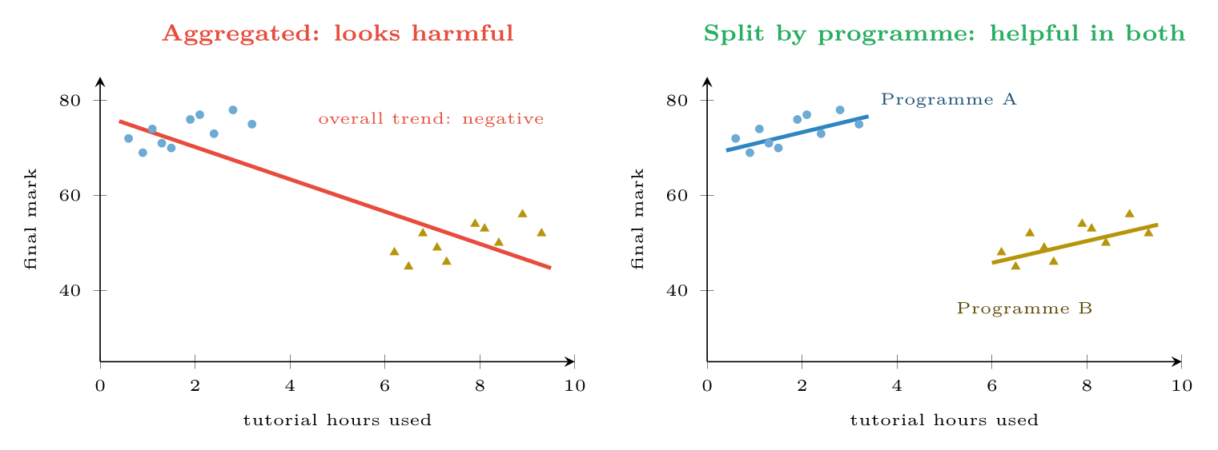
Simpson’s paradox
FIGURE 8.3
The same points, plotted twice. Aggregated, tutorial use appears to lower marks; within each programme it raises them. Programme is a confounder — students on the harder programme use tutorials more and score lower for unrelated reasons.
Data Science · Chapter 8 · Exploratory Data Analysis and Visualisation
§8.4 · Handout p. 51 19
Notes:
Figure 8.3 (handout p. 51): Simpson’s paradox. The same points, plotted twice. Aggregated, tutorial use appears to lower marks; within each programme it raises them. Programme is a confounder — students on the harder programme use tutorials more and score lower for unrelated reasons.

Slide 20
Visualisation Anti-Patterns
SECTION 5 OF 5
8.5
8.1 What EDA Is For
8.2 Choosing the Right Chart
8.3 Bivariate Exploration
8.4 The Third Variable
8.5 Visualisation Anti-Patterns
Data Science · Chapter 8
Handout §8.5 20
Notes:
Pause. Name the question this section answers.

Slide 21

Visualisation Anti-Patterns
AT A GLANCE
Anti-pattern | The distortion | The fix
Truncated y-axis on a bar chart | Bar length no longer encodes value; a 2% change looks like a doubling | Bars must start at zero. Use a line chart if you need to zoom
Dual y-axes | The apparent correlation depends entirely on where you set the two scales | Two stacked panels sharing an x-axis
3-D effects | Perspective makes near bars look larger | Never use them
Rainbow colour scale | Not perceptually uniform; invents boundaries that are not in the data | Sequential (light-to-dark) for magnitude, diverging for signed
Red/green as the only cue | Invisible to about 1 in 12 men | Add shape or position; use blue/orange
Too many lines | Above five series nothing is legible | Small multiples, or highlight one and grey the rest
Averaging away the shape | A single mean hides bimodality entirely | Show the distribution: histogram, boxplot or strip plot
Data Science · Chapter 8 · Exploratory Data Analysis and Visualisation
§8.5 · Handout p. 51 21
Notes:
Do not read the table row by row: pick the row the room is most likely to get wrong and ask why.

Slide 22

One Test for Any Chart
CONCEPT
Cover the title and hand it to a colleague. If they cannot state the main message in one sentence within about ten seconds, the chart is not finished. This test catches more problems than any style guide.
Data Science · Chapter 8 · Exploratory Data Analysis and Visualisation
§8.5 · Handout p. 51 22
Notes:
Read the box aloud, then ask for an example from the room before moving on.

Slide 23





Four lenses: Exploratory Analysis
FOUR LENSES
LEARNING ANALYTICS
PROJECT MANAGEMENT
Plot engagement over the weeks of the semester as one line per student, faintly, with the cohort median in bold — the “spaghetti plot”.
Plot estimated against actual effort as a scatterplot with the y=x line drawn.
INTERNET OF THINGS
CYBERSECURITY
With 400 devices you cannot plot 400 lines.
Log-scale nearly everything — counts of events per source are long-tailed, and a linear axis renders all but the largest invisible.
Data Science · Chapter 8 · Exploratory Data Analysis and Visualisation
Handout p. 54 23
Notes:
The same method, four domains. Each of the next four slides opens one lens in full.

Slide 24

Learning Analytics: Exploratory Analysis
FOUR LENSES
LEARNING ANALYTICS
Project Management
Plot engagement over the weeks of the semester as one line per student, faintly, with the cohort median in bold — the “spaghetti plot”. The shape of individual disengagement (a cliff in week 5 versus a slow decline) is invisible in any average and is exactly what the intervention design needs. Always split by programme before presenting: Simpson’s paradox is endemic in education data.
Internet of Things
Cybersecurity
Data Science · Chapter 8 · Exploratory Data Analysis and Visualisation
Handout p. 54 24
Notes:
Learning Analytics. Plot engagement over the weeks of the semester as one line per student, faintly, with the cohort median in bold — the “spaghetti plot”. The shape of individual disengagement (a cliff in week 5 versus a slow decline) is invisible in any average and is exactly what the intervention design needs. Always split by programme before presenting: Simpson’s paradox is endemic in education data.

Slide 25

Project Management: Exploratory Analysis
FOUR LENSES
PROJECT MANAGEMENT
Learning Analytics
Plot estimated against actual effort as a scatterplot with the y=x line drawn. The systematic gap above that line is the estimation bias, and it is far more persuasive to a team than any summary statistic. A cumulative flow diagram shows where work piles up; a burn-down chart alone does not.
Internet of Things
Cybersecurity
Data Science · Chapter 8 · Exploratory Data Analysis and Visualisation
Handout p. 54 25
Notes:
Project Management. Plot estimated against actual effort as a scatterplot with the y=x line drawn. The systematic gap above that line is the estimation bias, and it is far more persuasive to a team than any summary statistic. A cumulative flow diagram shows where work piles up; a burn-down chart alone does not.

Slide 26

Internet of Things: Exploratory Analysis
FOUR LENSES
INTERNET OF THINGS
Learning Analytics
With 400 devices you cannot plot 400 lines. Use a heatmap of device × time with colour as the reading: a failing sensor appears as a stripe, a site-wide outage as a vertical band. This one chart replaces 400 line charts and reveals patterns none of them would show individually.
Project Management
Cybersecurity
Data Science · Chapter 8 · Exploratory Data Analysis and Visualisation
Handout p. 54 26
Notes:
Internet of Things. With 400 devices you cannot plot 400 lines. Use a heatmap of device × time with colour as the reading: a failing sensor appears as a stripe, a site-wide outage as a vertical band. This one chart replaces 400 line charts and reveals patterns none of them would show individually.

Slide 27

Cybersecurity: Exploratory Analysis
FOUR LENSES
CYBERSECURITY
Learning Analytics
Log-scale nearly everything — counts of events per source are long-tailed, and a linear axis renders all but the largest invisible. Plot volume by hour of day to establish the normal diurnal rhythm, because deviation from the rhythm is more informative than raw volume. Never truncate an axis on a security chart: it is how a small anomaly is made to look like a crisis, and how a real one gets missed.
Project Management
Internet of Things
Data Science · Chapter 8 · Exploratory Data Analysis and Visualisation
Handout p. 54 27
Notes:
Cybersecurity. Log-scale nearly everything — counts of events per source are long-tailed, and a linear axis renders all but the largest invisible. Plot volume by hour of day to establish the normal diurnal rhythm, because deviation from the rhythm is more informative than raw volume. Never truncate an axis on a security chart: it is how a small anomaly is made to look like a crisis, and how a real one gets missed.

Slide 28

Try it yourself: A Standard EDA Pass
TRY IT YOURSELF
WHAT YOU WILL DO
1. Univariate: shape of every numeric column
2. Bivariate: relationships and multicollinearity
3. The third variable: always check before presenting
THIS WEEK'S LAB
WHAT YOU WILL RUN
Week 5: Standard EDA pass
2 listings, 29 lines of Python, R
Data Science · Chapter 8 · Exploratory Data Analysis and Visualisation
§8.5 · Handout p. 51 28
Notes:
Say what the room will have at the end of the lab, then let them start. Circulate rather than lecture.

Slide 29
A Standard EDA Pass
LAB · STEP 1 OF 4 · LISTING 1
Set-up
Python
1
2
3
import pandas as pd, matplotlib.pyplot as plt, seaborn as sns
df = pd.read_csv("students.csv")
Data Science · Chapter 8 · Exploratory Data Analysis and Visualisation
§8.5 · Handout p. 51 29
Notes:
Step 1: Set-up. Read the code aloud; ask what each line would print before running it.

Slide 30
A Standard EDA Pass
LAB · STEP 2 OF 4 · LISTING 1
Univariate: shape of every numeric column
Python
4
5
6
# --- 1. univariate: shape of every numeric column ---------------------
df.select_dtypes("number").hist(bins=30, figsize=(11, 7))
plt.tight_layout(); plt.show()
Data Science · Chapter 8 · Exploratory Data Analysis and Visualisation
§8.5 · Handout p. 51 30
Notes:
Step 2: Univariate: shape of every numeric column. Read the code aloud; ask what each line would print before running it.

Slide 31
A Standard EDA Pass
LAB · STEP 3 OF 4 · LISTING 1
Bivariate: relationships and multicollinearity
Python
7
8
9
10
11
12
13
14
15
16
17
18
# --- 2. bivariate: relationships and multicollinearity ----------------
corr = df.select_dtypes("number").corr()
sns.heatmap(corr, annot=True, fmt=".2f", cmap="RdBu_r",
center=0, vmin=-1, vmax=1) # diverging scale for signed values
plt.show()
# Flag pairs that are nearly the same variable measured twice.
import numpy as np
high = (corr.abs() > 0.85) & (corr.abs() < 1.0)
print("multicollinear pairs:",
[(a, b) for a in corr.index for b in corr.columns
if high.loc[a, b] and a < b])
Data Science · Chapter 8 · Exploratory Data Analysis and Visualisation
§8.5 · Handout p. 51 31
Notes:
Step 3: Bivariate: relationships and multicollinearity. Read the code aloud; ask what each line would print before running it.

Slide 32
A Standard EDA Pass
LAB · STEP 4 OF 4 · LISTING 1
The third variable: always check before presenting
Python
19
20
21
22
# --- 3. the third variable: always check before presenting ------------
sns.lmplot(data=df, x="tutorial_hours", y="final_mark",
hue="programme", height=4) # per-group, not aggregated
plt.show()
Data Science · Chapter 8 · Exploratory Data Analysis and Visualisation
§8.5 · Handout p. 51 32
Notes:
Step 4: The third variable: always check before presenting. Read the code aloud; ask what each line would print before running it.

Slide 33
A Standard EDA Pass
LAB · STEP 1 OF 1 · LISTING 2
Set-up
R
1
2
3
4
library(tidyverse); library(GGally)
ggpairs(select(df, where(is.numeric)))
ggplot(df, aes(tutorial_hours, final_mark, colour = programme)) +
geom_point() + geom_smooth(method = "lm")
Data Science · Chapter 8 · Exploratory Data Analysis and Visualisation
§8.5 · Handout p. 51 33
Notes:
Step 1: Set-up. Read the code aloud; ask what each line would print before running it.

Slide 34
What the lab shows
TRY IT YOURSELF
R equivalent, matching the repo’s existing mtcars EDA lab:
Data Science · Chapter 8 · Exploratory Data Analysis and Visualisation
§8.5 · Handout p. 51 34
Notes:
Read the box aloud, then ask for an example from the room before moving on.

Slide 35

Two features correlate at r = 0.96 with each other. What is this called and what should you do before fitting a linear model?
CHECKPOINT 1 OF 3
Discuss with the person next to you, then advance.
Data Science · Chapter 8 · Exploratory Data Analysis and Visualisation
Handout p. 54 · answers in Appendix D 35
Notes:
Ask the room. Do not advance until someone commits to an answer.

Slide 36

Two features correlate at r = 0.96 with each other. What is this called and what should you do before fitting a linear model?
CHECKPOINT 1 OF 3 · ANSWER
Multicollinearity. Drop one of the pair (or use ridge). Keeping both adds almost no information and makes the coefficients unstable and uninterpretable.
Data Science · Chapter 8 · Exploratory Data Analysis and Visualisation
Handout p. 54 · answers in Appendix D 36
Notes:
Answer (Appendix D): Multicollinearity. Drop one of the pair (or use ridge). Keeping both adds almost no information and makes the coefficients unstable and uninterpretable.

Slide 37
A scatterplot shows a clear U-shape and r = 0.02. Is there a relationship?
CHECKPOINT 2 OF 3
Discuss with the person next to you, then advance.
Data Science · Chapter 8 · Exploratory Data Analysis and Visualisation
Handout p. 54 · answers in Appendix D 37
Notes:
Ask the room. Do not advance until someone commits to an answer.

Slide 38
A scatterplot shows a clear U-shape and r = 0.02. Is there a relationship?
CHECKPOINT 2 OF 3 · ANSWER
Yes — a strong non-linear one. Pearson’s r measures only linear association, which is why Figure 8.2 exists.
Data Science · Chapter 8 · Exploratory Data Analysis and Visualisation
Handout p. 54 · answers in Appendix D 38
Notes:
Answer (Appendix D): Yes — a strong non-linear one. Pearson’s r measures only linear association, which is why Figure 8.2 exists.

Slide 39
You must compare failure rates across 40 servers over 30 days. Which chart, and why not 40 line charts?
CHECKPOINT 3 OF 3
Discuss with the person next to you, then advance.
Data Science · Chapter 8 · Exploratory Data Analysis and Visualisation
Handout p. 54 · answers in Appendix D 39
Notes:
Ask the room. Do not advance until someone commits to an answer.

Slide 40
You must compare failure rates across 40 servers over 30 days. Which chart, and why not 40 line charts?
CHECKPOINT 3 OF 3 · ANSWER
A heatmap with servers on one axis and days on the other, colour showing the failure rate. Forty line charts cannot be compared visually, and a single chart with forty lines is illegible; the heatmap makes both per-server and site-wide patterns visible at once.
Data Science · Chapter 8 · Exploratory Data Analysis and Visualisation
Handout p. 54 · answers in Appendix D 40
Notes:
Answer (Appendix D): A heatmap with servers on one axis and days on the other, colour showing the failure rate. Forty line charts cannot be compared visually, and a single chart with forty lines is illegible; the heatmap makes both per-server and site-wide patterns visible at once.

Slide 41

What to take away
CHAPTER SUMMARY
1
EDA runs univariate → bivariate → multivariate, and its output is knowledge and hypotheses, not pictures.
2
Chart choice follows from variable types; the grid in Figure 8.1 answers almost every case.
3
Pearson’s r measures linear association only, and is easily dominated by a single high-leverage point. Always plot before trusting it.
4
Correlations above about 0.85 between features signal multicollinearity; keep one of the pair.
5
Simpson’s paradox means an aggregate relationship can reverse within groups. Always check the obvious grouping variable.
6
Truncated axes, dual axes, 3-D effects and rainbow scales are distortions, not styles.
Data Science · Chapter 8 · Exploratory Data Analysis and Visualisation
Handout p. 54 41
Notes:
Ask the room to say each takeaway before you reveal it.

Slide 42

Quick check 1 of 2
REVIEW · MULTIPLE CHOICE
Pearson’s r of 0 means:
A
no relationship
B
no linear relationship
C
the variables are independent
D
the data is normal
Data Science · Chapter 8 · Exploratory Data Analysis and Visualisation
Handout p. 54 42
Notes:
Take a show of hands for each option before discussing. (The handout does not print MCQ answers.)

Slide 43
Quick check 2 of 2
REVIEW · MULTIPLE CHOICE
For comparing the distribution of a numeric variable across five categories, the best chart is:
A
pie chart
B
stacked bar
C
boxplot by group
D
3-D column chart
Data Science · Chapter 8 · Exploratory Data Analysis and Visualisation
Handout p. 54 43
Notes:
Take a show of hands for each option before discussing. (The handout does not print MCQ answers.)

Slide 44
For your notebook
REVIEW QUESTIONS
SHORT
Explain why a bar chart must start at zero but a line chart need not.
SHORT
Define multicollinearity and state one concrete problem it causes.
SHORT
Describe Simpson’s paradox in two sentences and give an example from any domain.
APPLIED
You are handed a dataset of 15,000 login events with columns user, timestamp, source_ip, success, duration_s. Write the EDA plan: list the charts you would produce, in order, and state what each is meant to reveal.
APPLIED
A manager presents a chart with a truncated y-axis showing incidents “up 300%” (from 4 to 12). Rewrite the chart specification honestly, and say what additional context the reader needs.
Data Science · Chapter 8 · Exploratory Data Analysis and Visualisation
Handout p. 54 44
Notes:
Set these for independent study. Model answers are not printed in the handout.

Slide 45
End of Chapter 8
08
NEXT
READ
Chapter 9 — Inferential Statistics
Handout Chapter 8, pages 49–54
THIS WEEK'S LAB
ASSESSMENT
Standard EDA pass
Assignment 1 set
Data Science · Chapter 8 · Exploratory Data Analysis and Visualisation
45
Notes:
Close. NEXT: Chapter 9 — Inferential Statistics. READ: Handout Chapter 8, pages 49–54. THIS WEEK'S LAB: Standard EDA pass. ASSESSMENT: Assignment 1 set.

